Slide 1
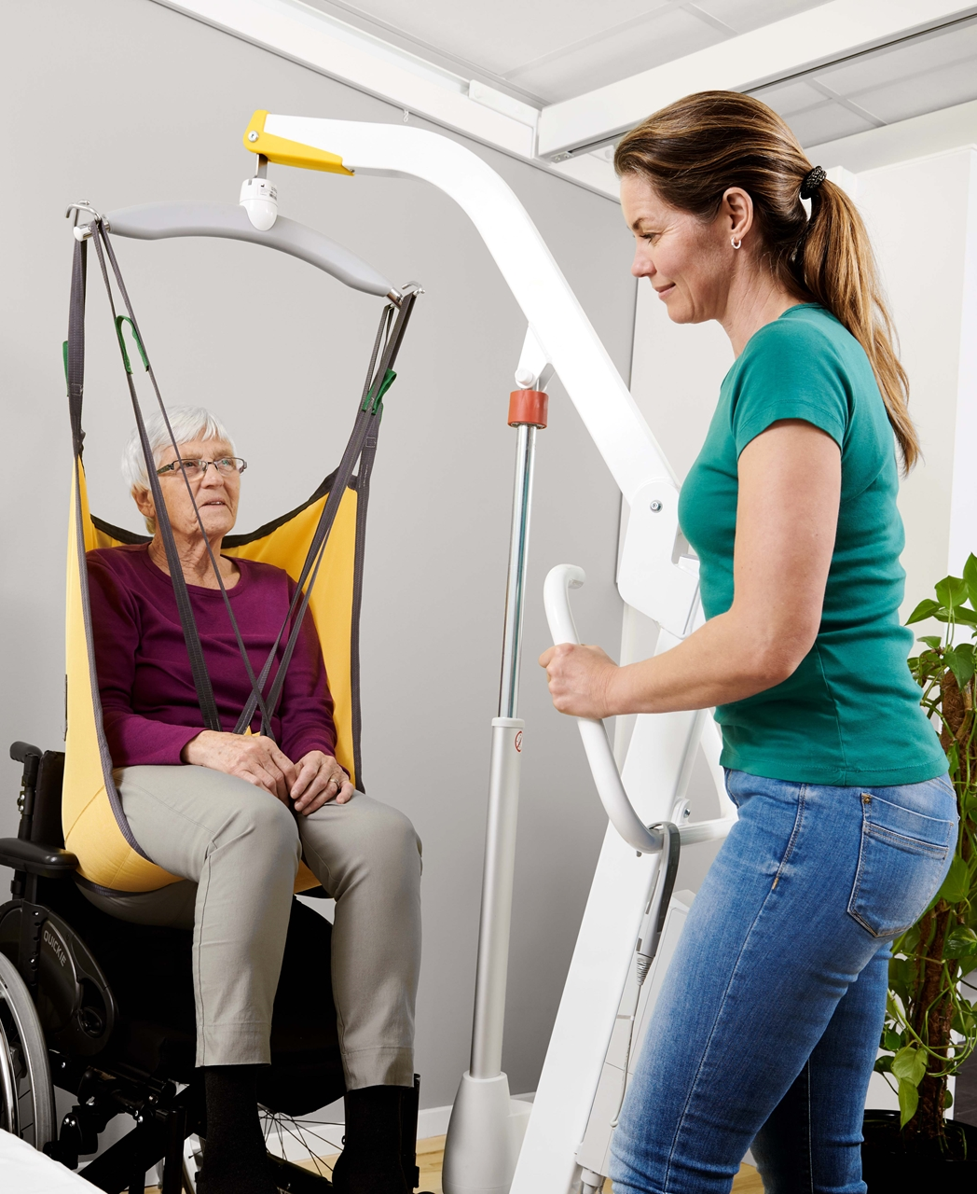
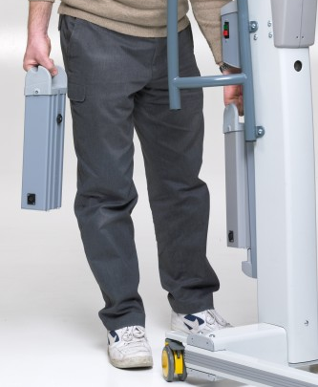
Limitations of Mobile Lifters
Compliance
Dead Batteries
Storage / limited space
Maneuverability
Limited SWL ability

Slide 2
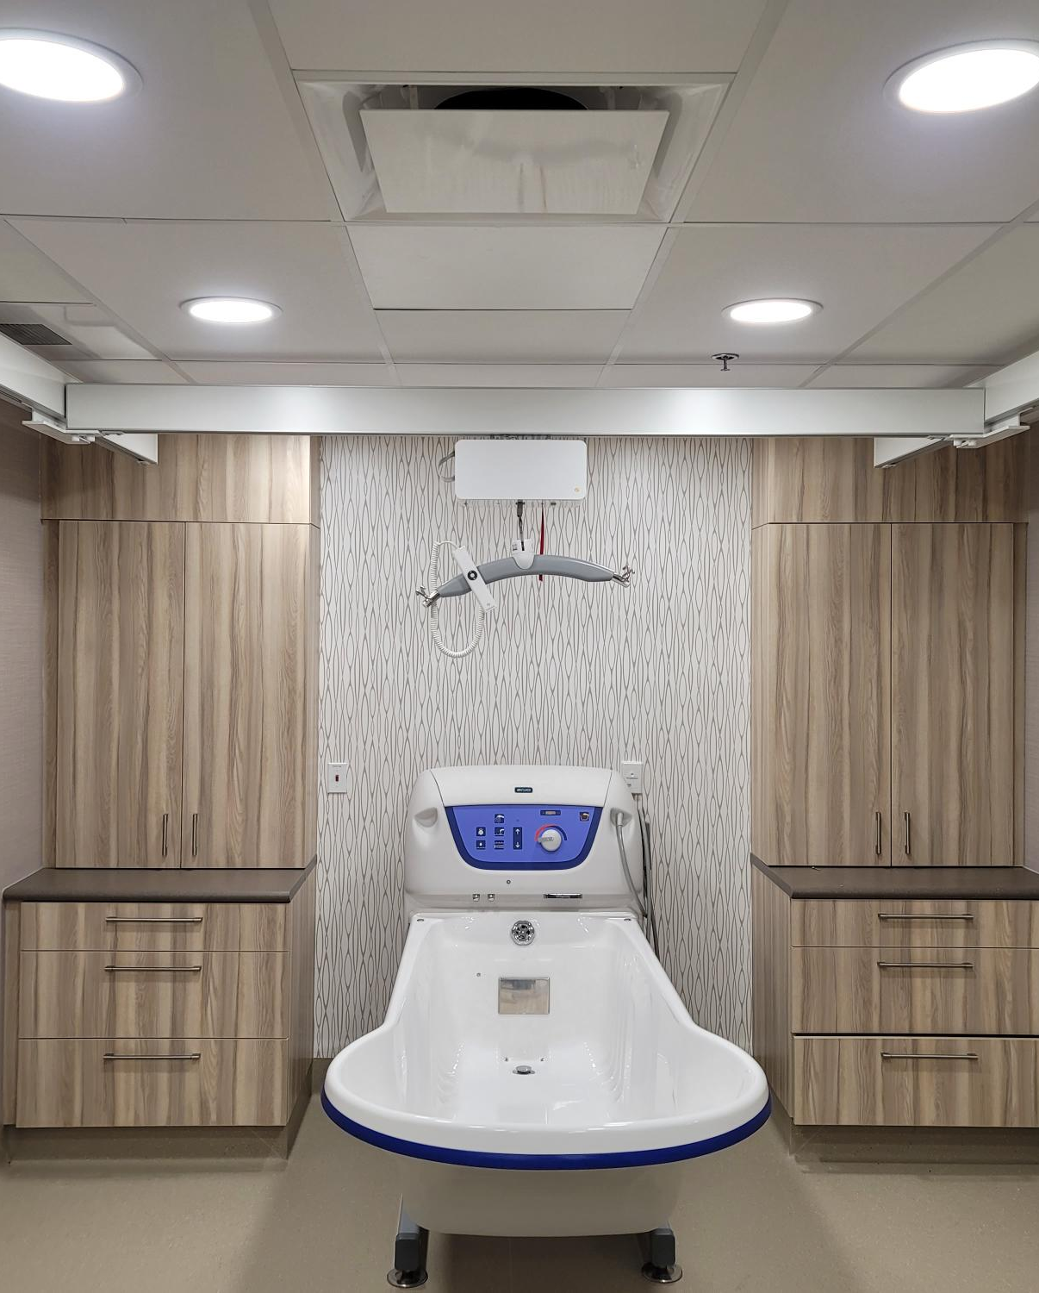
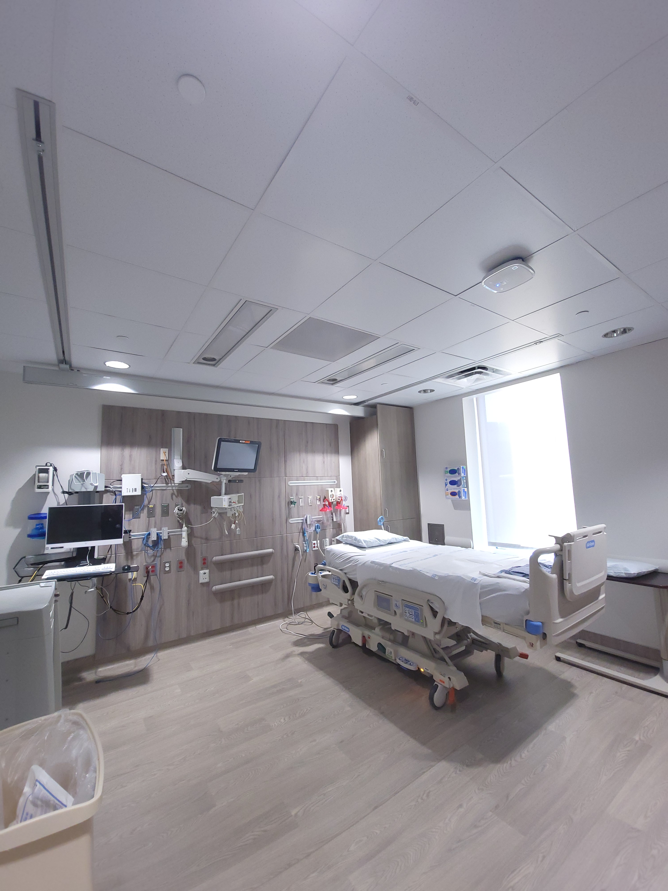
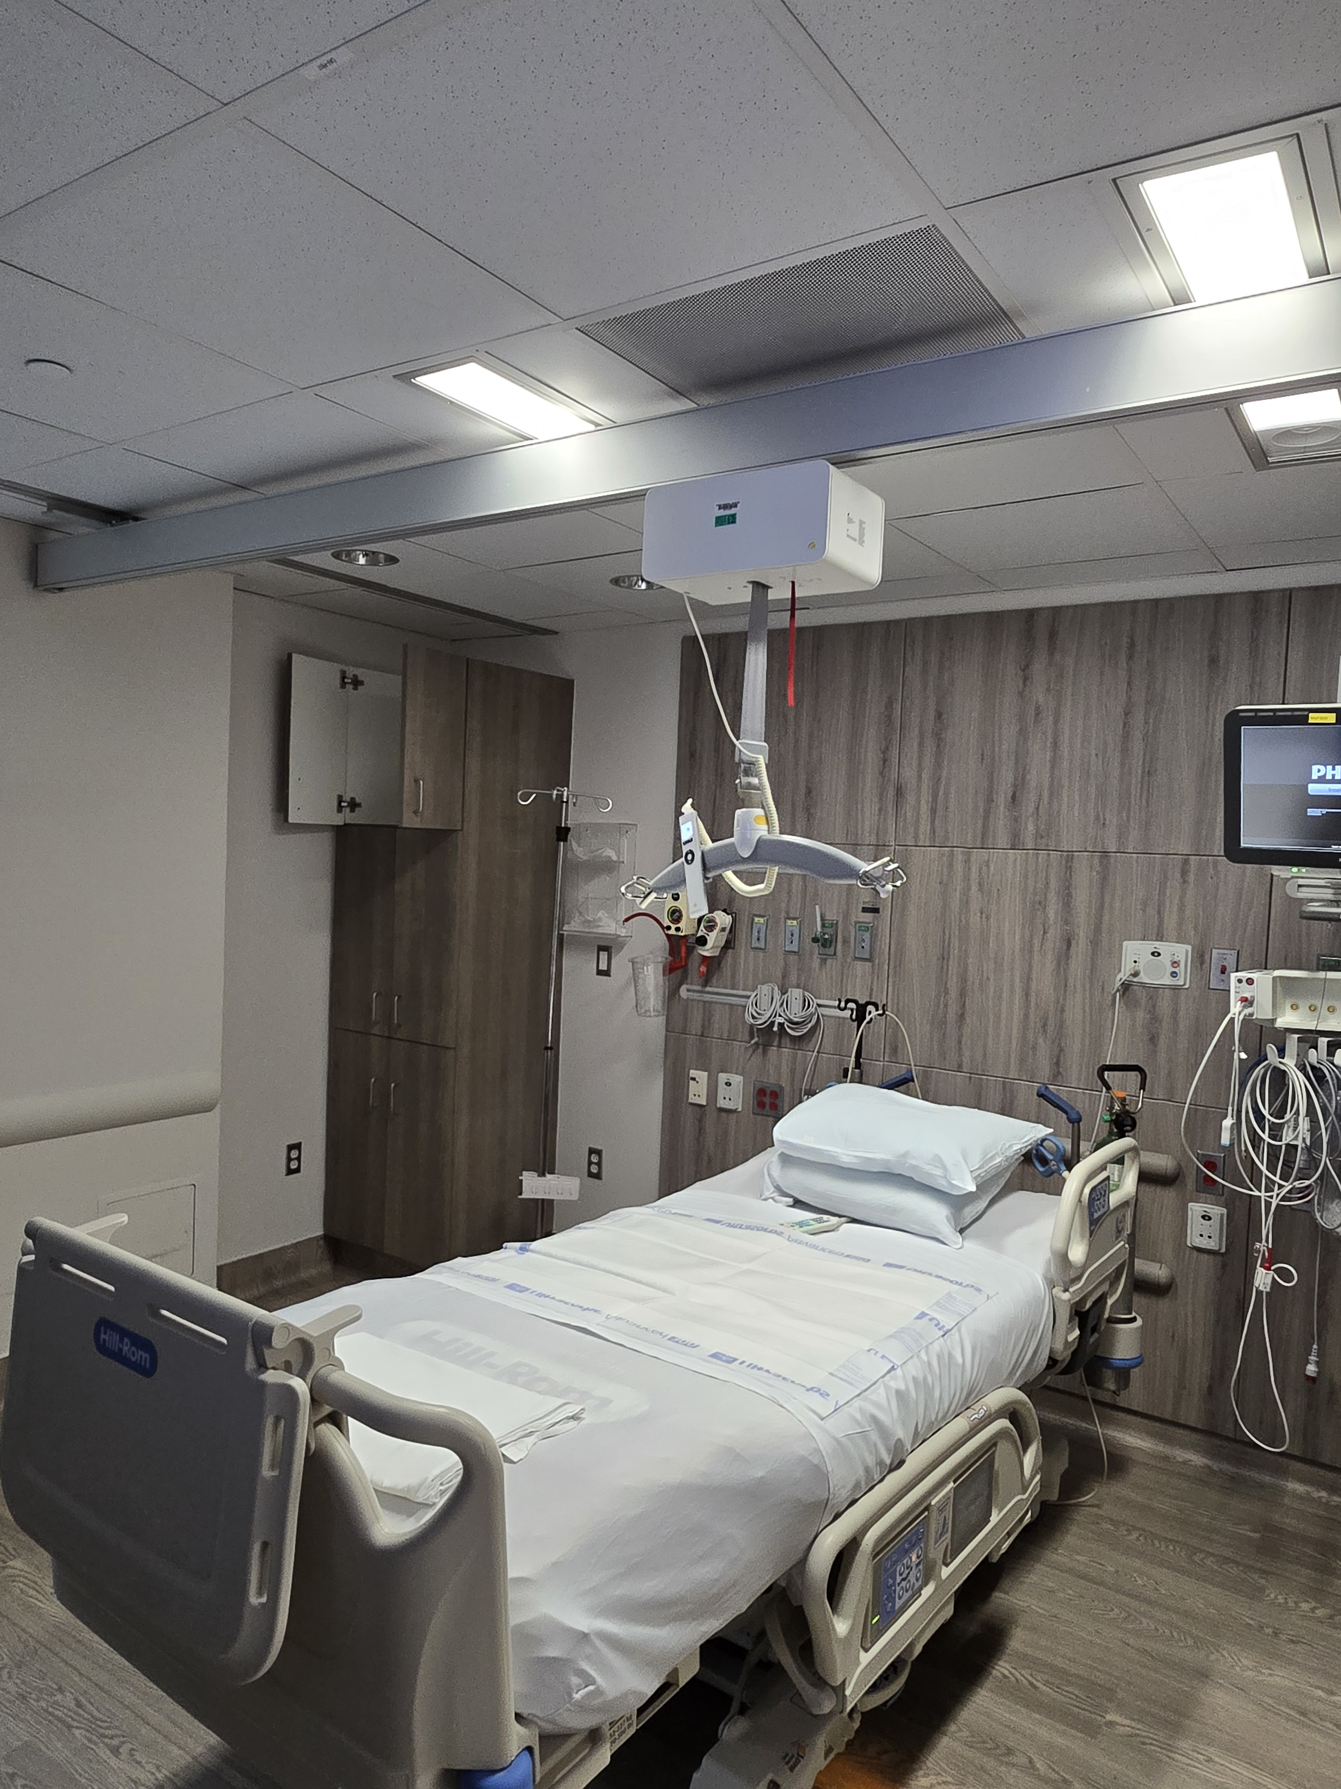
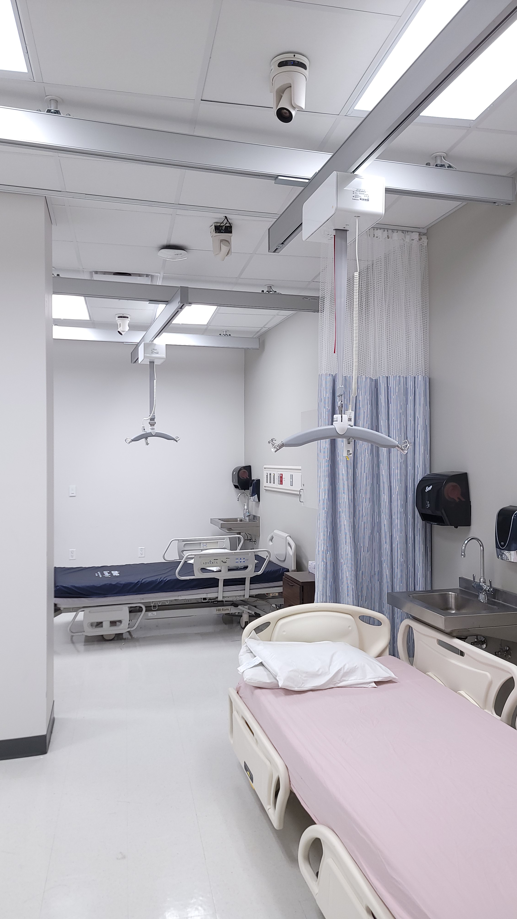
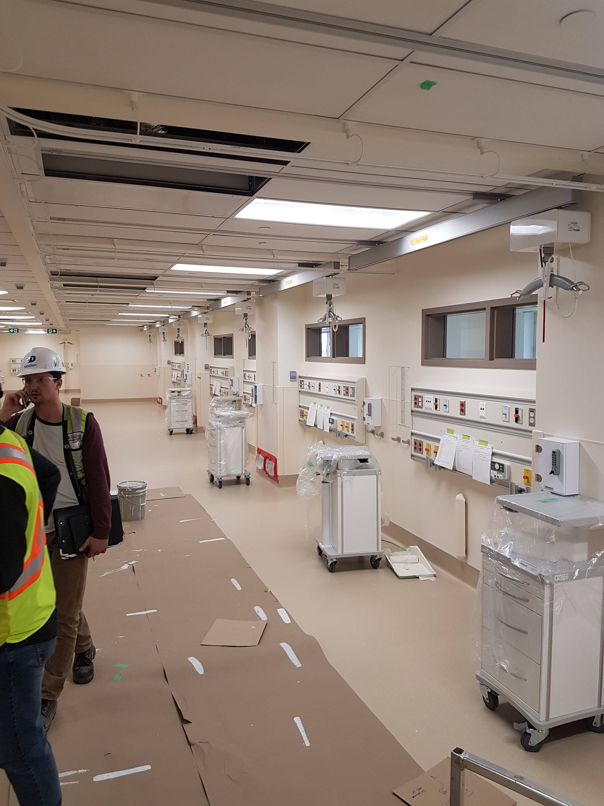
Ceiling Lift Advantages
Compliance
Dead Batteries
Storage / limited space
Maneuverability
Limited SWL ability

