Slide 3
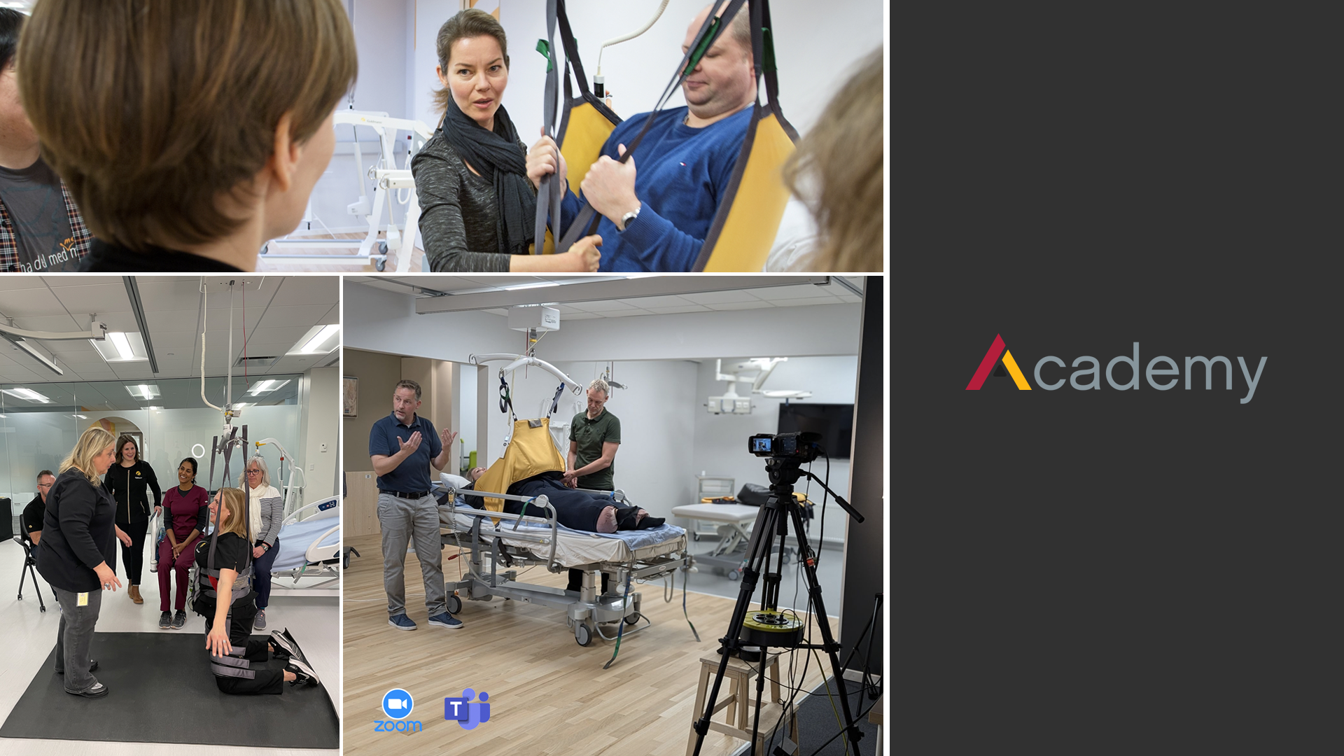
Notes:
Add this slides & picture of our Boston Lab as well as our ability to provide remote clinical support via video.

Slide 4
Transfer
Treatment
Training

